Slide 1
Where should I live in New Jersey?
Team Members: Archna Ashish, Ajay Patil, Mitesh Parekh

Slide 2


Project Outline: Analyze various socio-economic factors in New Jersey
Data Gathering
Data Cleansing
Data Normalizing
Data Shaping and Structuring
Data Analysis/Visualization
Story Telling

Slide 3
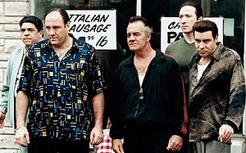
Crime
Source(s)
New Jersey State Police Crime Reports
(https://www.njsp.org/ucr/current-crime-data1.shtml)
Challenge(s):
Unstructured Data from Source
Analyzing 21 Counties Data
Variety/Severity of Crimes
Populating Township Name
Key Performance Indicator:
Serious Crimes Committed Rate (per 10,000 people)

Slide 4

Income
Source(s)
ZipAtlas.com
(http://zipatlas.com/us/nj/zip-code-comparison/median-household-income.htm)
Challenge(s):
Use of web info because Census Data available for 60K plus population towns.
Populating Township Name
Key Performance Indicator:
Average Household Income

Slide 5

Education
Source(s)
SchoolDigger.com (API)
(https://developer.schooldigger.com/)
Challenge(s):
Complex JSON file structure
District ~ Individual School
School Rankings vs. Score
Populating Township Name
Key Performance Indicator:
School Score

Slide 6

Property Tax
Source(s)
data.nj.gov
newjersey-demographics.com
zip-codes.com/state/nj.asp
Challenge(s):
Large Dataset: 3M+ records
Zip Code Normalization
Populating zip code for 2M+ residential records
Identifying non owner or Rented Properties
Key Performance Indicator:
Prior Year Property Tax

Slide 7

Housing Valuation
Source(s)
NJ.gov
Challenge(s):
Large Dataset: 2M+ residential property records
Reported Net Value vs. Market Value
Key Performance Indicator:
Property Market Value = (Property Tax / Tax Rate) / True Value Ratio

Slide 8
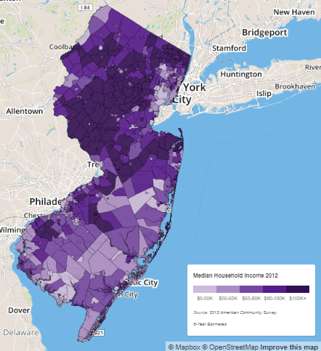
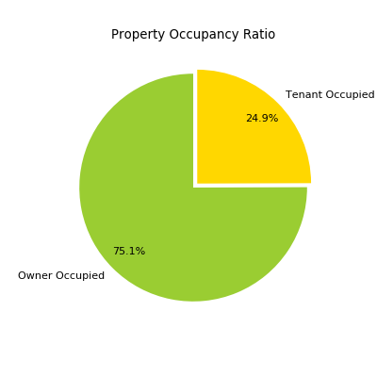
What are we analyzing ?
21 counties
565 municipalities
759 Zip Codes
Five types: 254 boroughs, 52 cities, 15 towns, 241 townships, and 3 villages.
Owner Occupied vs. Investment/Rental
Total Available Tax Records: 3,168,402
Total Residential properties:: 2,566,541
Owner Occupied: 1,926,215
Investment or Tenant Occupied: 640,326
Investment/Total Residential Ratio = 24.94%

Slide 9
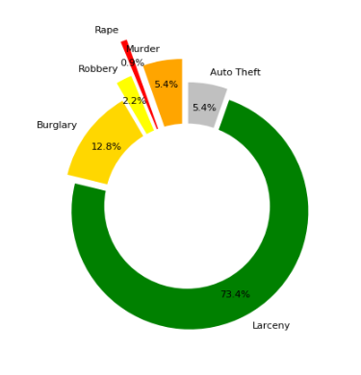
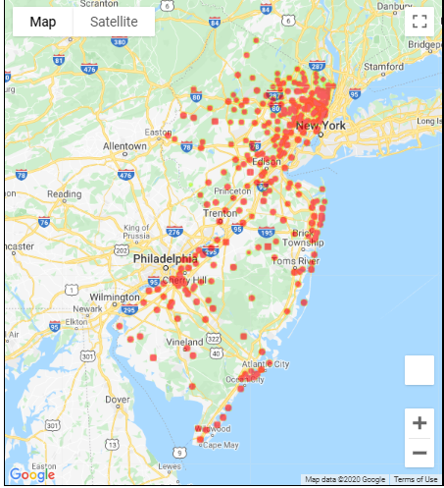
Housing Value vs. Serious Crime Rate
Not all crimes should be valued the same
Serious Crimes: Burglary, Robbery, Rape, Murder
Slight negative correlation b/t property value and serious crime rate (-.13)
7 of out of bottom 10 (highest rates) were located in Southern NJ

Slide 10
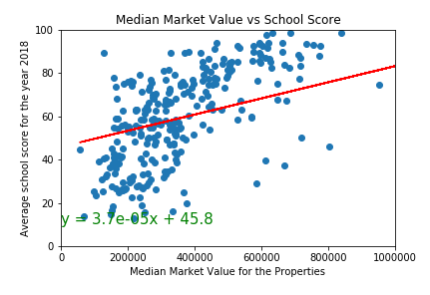
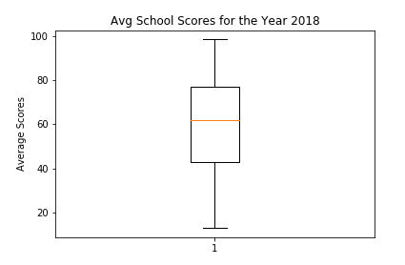
Housing Value vs. School Score
Positive Correlation between property value and school rating (.48)
Median School Score: 61.2
37% of schools have a 70 or higher score
8 of the top 10 rated towns were in Bergen and Essex counties

Slide 11
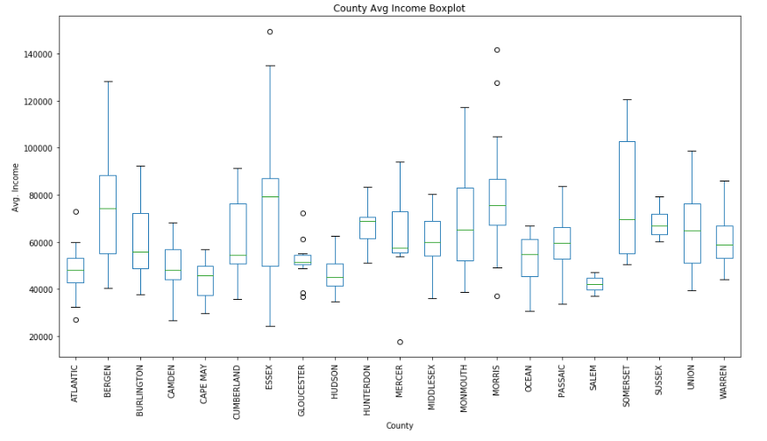
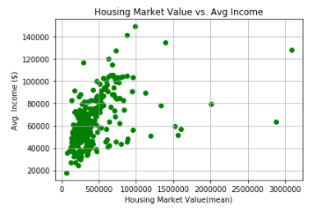
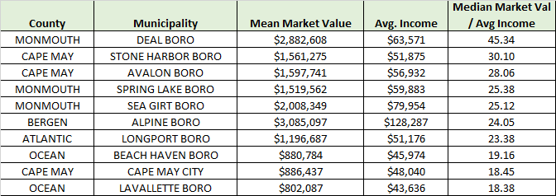
Housing Value vs. Avg. Income
Positive Correlation between housing market value and average household income (Pearson Correlation = 0.46)
Top 10 cities mostly located near the shore due to historical appreciation
Top 10

Slide 12
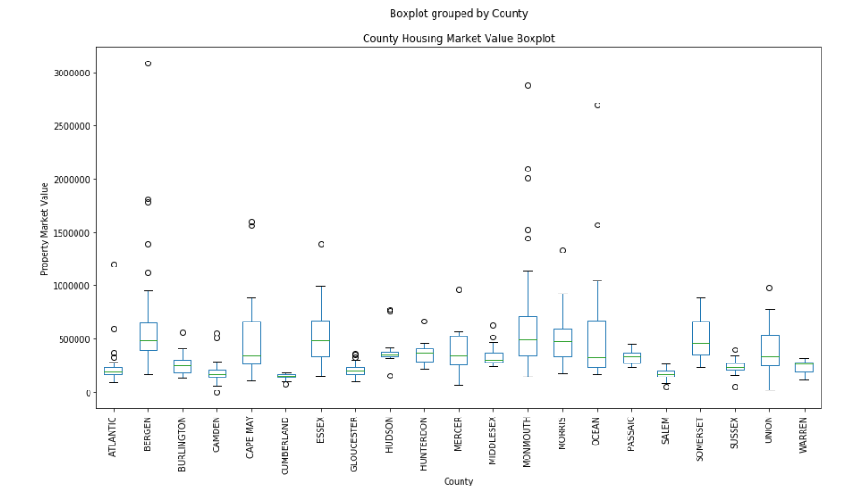
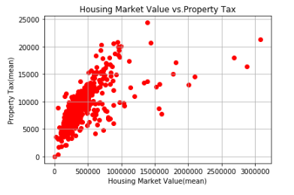
Housing Value vs. Property Tax
Top 10
Strong Positive Correlation between housing market value and annual property tax (Pearson Correlation = 0.66)
Lot of property market value volatility at county level
Top 10 cities mostly located near the shore due to historical appreciation, high market values may be too pricy

Slide 13
Conclusions
Socioeconomic factors correlated to Housing Market Value:
Property Tax
Average Income
School Score
Correlations does not automatically mean ideal location due to expensive homes
Ideal Home Factors
Metric | Criteria
Market Price | < $400K
Property Tax | < $7K
Avg. Income | > $40K
Severe Crime Rate (per 10k) | < 150
School Rating | > 70

Slide 14
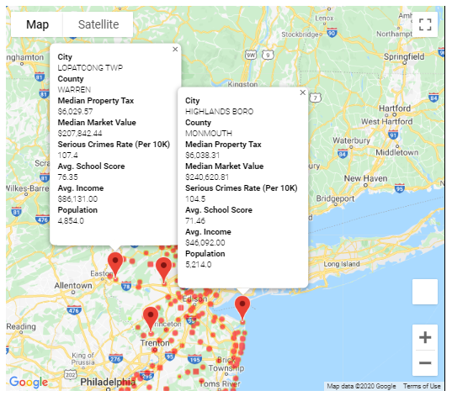
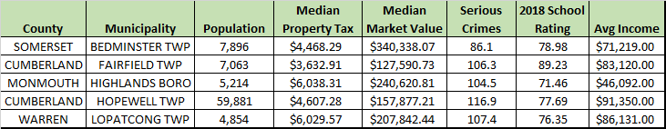
Best Towns to live in New Jersy
Disclaimer: None of our team member lives in any of these towns

Slide 15
Questions?

